Slide 1
STOCK PREDICTION
DSCI – 6007 - 02 - Team – 1
GIT Link

Slide 2
Team Working On this
Nithish Kumar Mayavan
Data Scientist
Sri Sai Durga Myneni
Data Modeler
Vinaykumar Reddy Moku
Machine Learning Engineer
Sri Sai Bhavana Pakalapati
Data Analyst

Slide 3
Problem statement
How can we leverage stock price prediction to optimize our investment strategy in Google stocks?
Can stock price prediction help us identify strategic opportunities for Google stock investments in the long term?

Slide 4
The Solution
Develop a stock price prediction model tailored to Google stocks, incorporating historical price data, relevant financial indicators, and external factors affecting Google's performance. Implement the model within our investment decision-making process to identify optimal entry and exit points for Google stock investments.
Develop a long-term stock price prediction model for Google that accounts for macroeconomic trends, industry developments, and Google's strategic initiatives. Use the model to identify potential growth opportunities or undervalued periods for Google stocks, guiding strategic investment decisions aimed at maximizing returns over the long term.

Slide 5
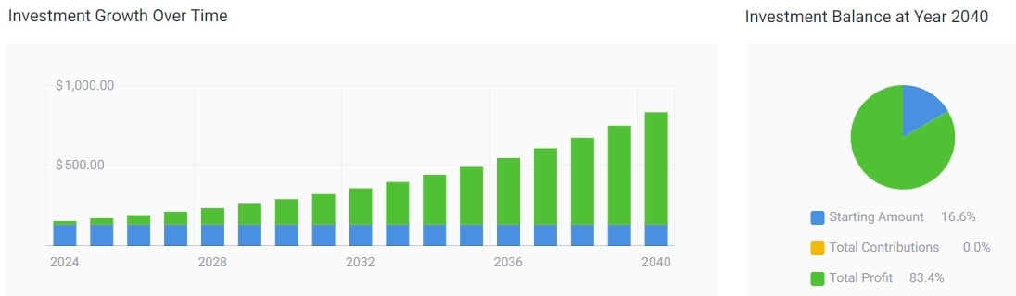
Market size

Slide 6
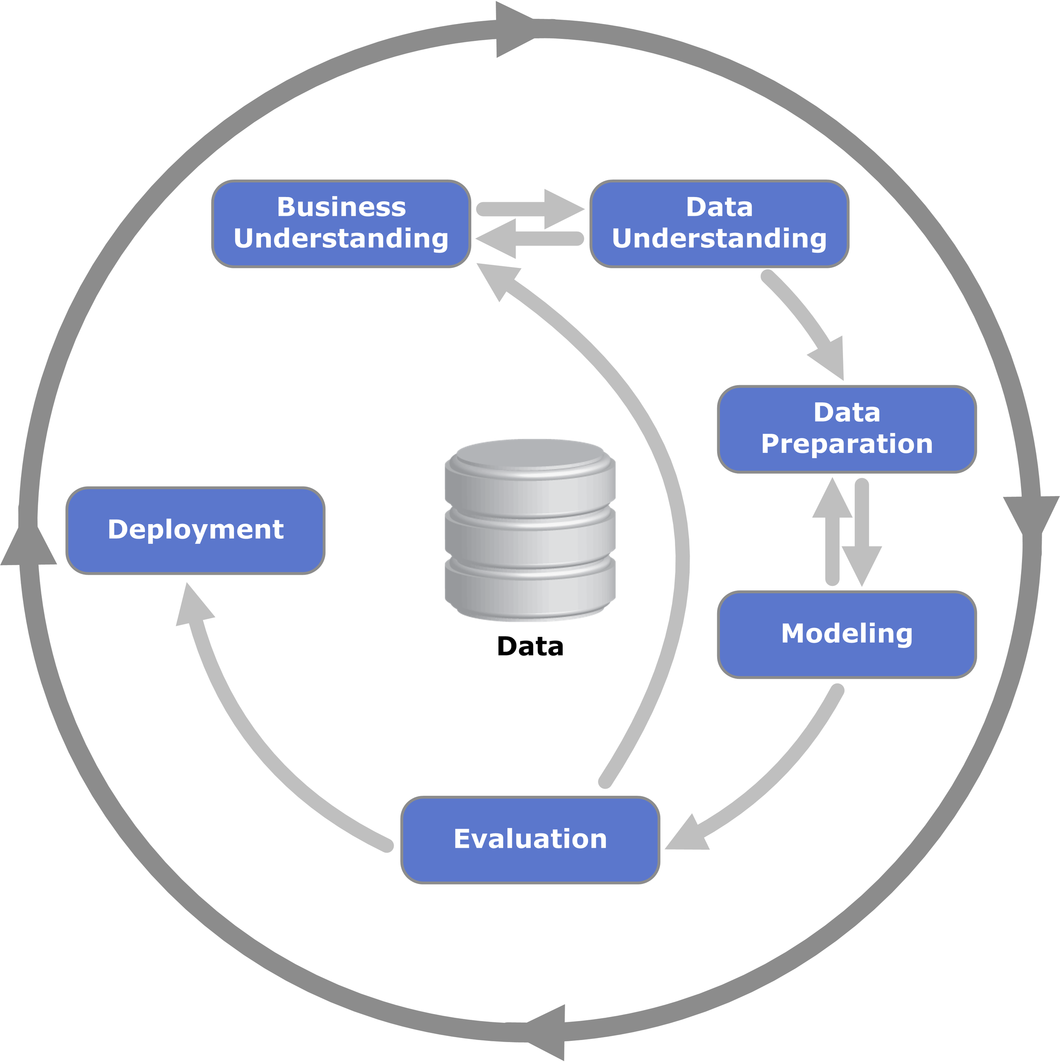
Business Model

Slide 7
Market Analysis and Trends: A fundamental aspect of understanding stock prediction involves a comprehensive analysis of the market and identifying relevant trends. This includes assessing macroeconomic factors, industry-specific conditions, and market sentiment. Businesses need to stay informed about global events, economic indicators, and sector-specific developments that could impact stock prices.
Data-driven Decision Making: Successful stock prediction relies heavily on data-driven decision-making. Businesses should leverage advanced analytics, machine learning models, and historical stock data to identify patterns and correlations. This involves employing algorithms that can analyze vast amounts of financial data to uncover insights, helping businesses make informed predictions about future stock movements.
Business Understanding
Risk Management and Uncertainty: The business understanding of stock prediction should also encompass the recognition of inherent risks and uncertainties in financial markets. Companies need to implement robust risk management strategies that account for factors such as market volatility, geopolitical events, and unforeseen circumstances. A holistic approach to stock prediction involves not only forecasting potential gains but also mitigating risks to protect investments and assets.

Slide 8

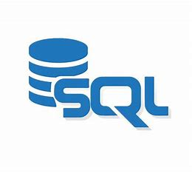

Python is a versatile programming language for data analysis. Libraries such as NumPy, Pandas, and SciPy are widely used for data manipulation and analysis.
Technologies
Structured Query Language (SQL) databases like MySQL and PostgreSQL are used for data storage and retrieval.
Tools like Plotly and Matplotlib enable the creation of interactive and informative data.

Slide 9
Road map
Data Collection
Data Integration
Data Cleaning
Implementation
Exploratory Data Analysis
Data Preparation

Slide 10
Thank You

